Slide 1
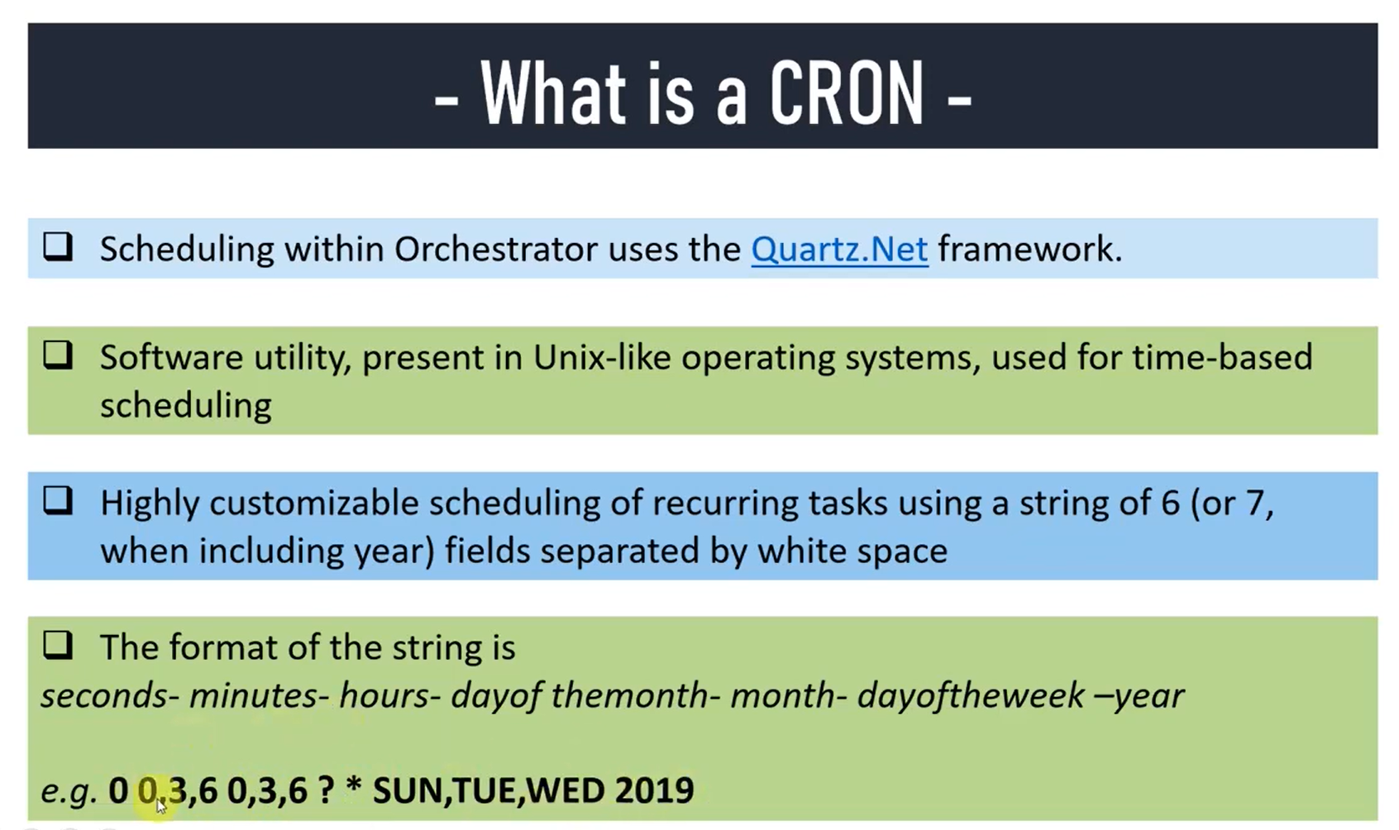

Slide 2
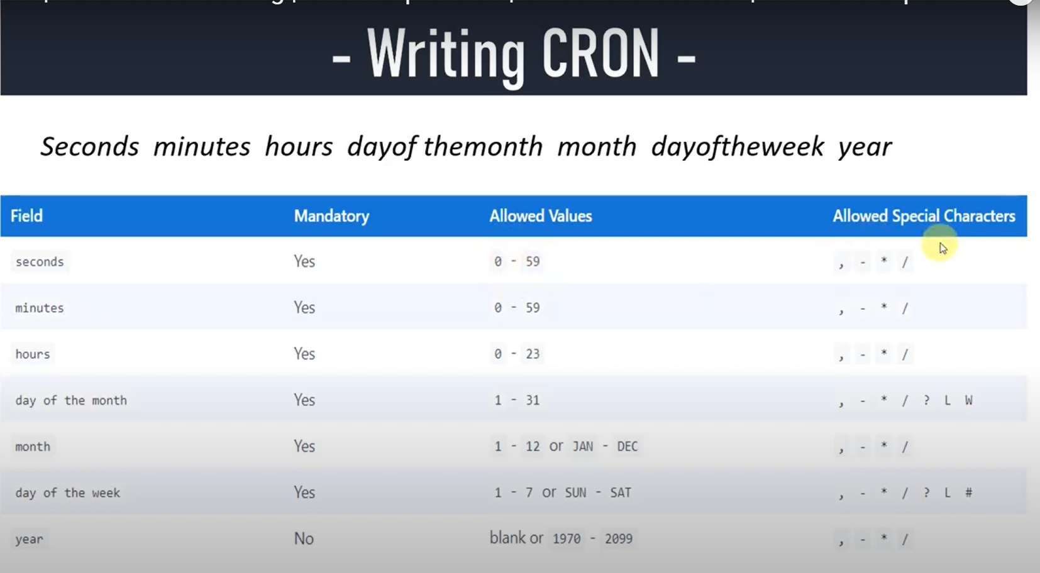

Slide 3
Useful Websites
https://docs.uipath.com/orchestrator/docs/using-cron-expressions
https://www.freeformatter.com/cron-expression-generator-quartz.html

